Slide 1
JA-trie: Entropy-Based Packet Classiﬁcation
Author: Gianni Antichi, Christian Callegari, Andrew W. Moore
, Stefano Giordano, Enrico Anastasi
Conference : 2014 IEEE 15th International Conference on High Performance Switching and Routing (HPSR)
Presenter: Yen-Chun Tseng
Date: 2014/8/5
Department of Computer Science and Information Engineering
National Cheng Kung University, Taiwan R.O.C.
Notes:
1

Slide 2
Outline
Introduction
Proposed scheme
Performance Evaluation

Slide 3
Introduction
  A novel trie-based classiﬁcation algorithm, named Jump-Ahead Trie (JA-trie).
  An entropy based pre-processing step is applied to the classiﬁcation rule-set
Notes:
When packet matches expression, may do less work than Thompson's
algorithm

Slide 4
Outline
Introduction
Proposed scheme
Performance Evaluation

Slide 5
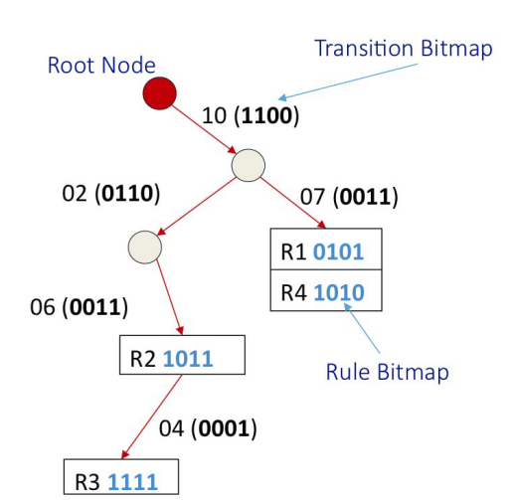
Proposed scheme
transition bitmap
rule bitmap

Slide 6
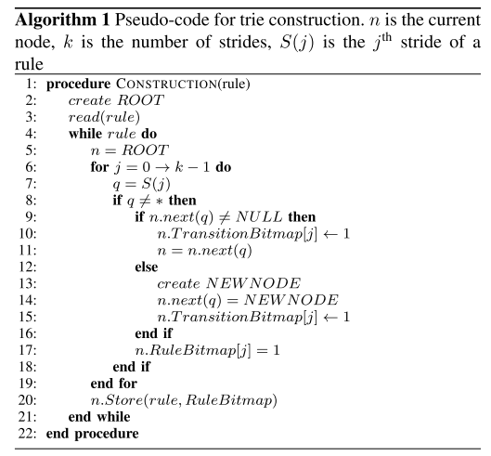
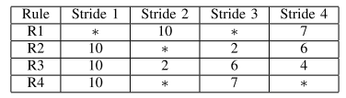
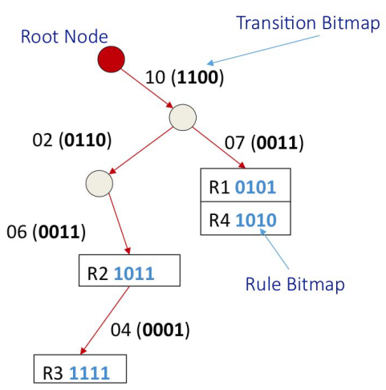
Proposed scheme

Slide 7
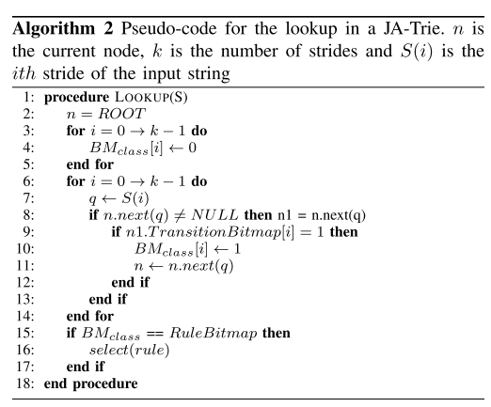
Proposed scheme

Slide 8
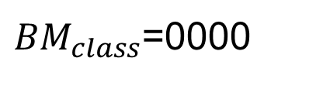
Proposed scheme
Packet (5:10:5:7)
${BM}_{class}$=0000

Slide 9
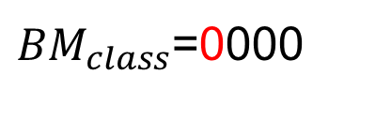
Proposed scheme
Packet (5:10:5:7)
${BM}_{class}$=0000

Slide 10
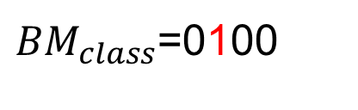
Proposed scheme
Packet (5:10:5:7)
${BM}_{class}$=0100

Slide 11
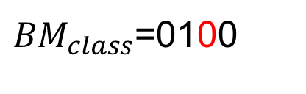
Proposed scheme
Packet (5:10:5:7)
${BM}_{class}$=0100

Slide 12
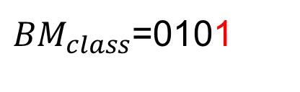
Proposed scheme
Packet (5:10:5:7)
${BM}_{class}$=0101

Slide 13
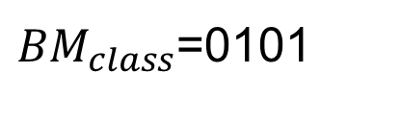
Proposed scheme
Packet (5:10:5:7)
${BM}_{class}$=0101

Slide 14
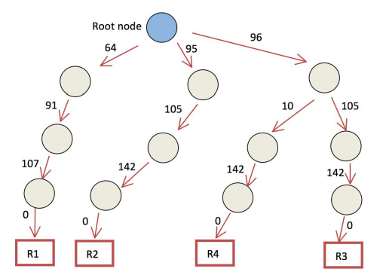

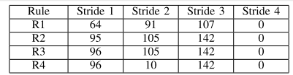
Proposed scheme
Entropy-Based-JA-Trie

Slide 15
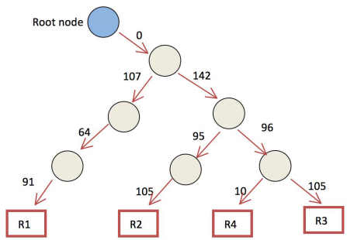
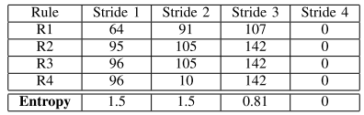
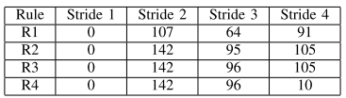
Proposed scheme
Entropy-Based-JA-Trie

Slide 16
Outline
Introduction
Proposed scheme
Performance Evaluation

Slide 17
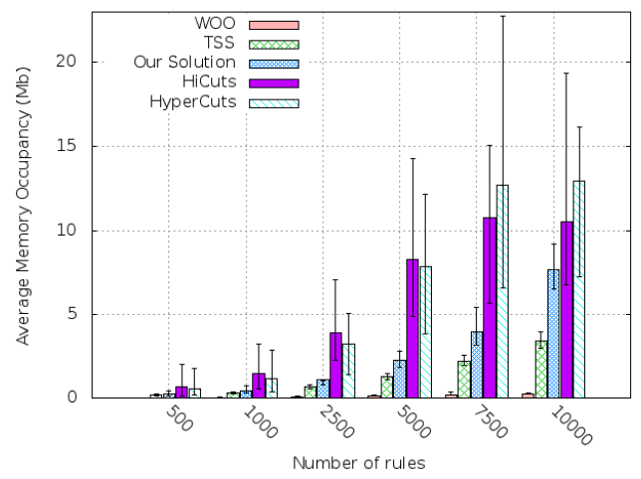
Performance Evaluation

Slide 18
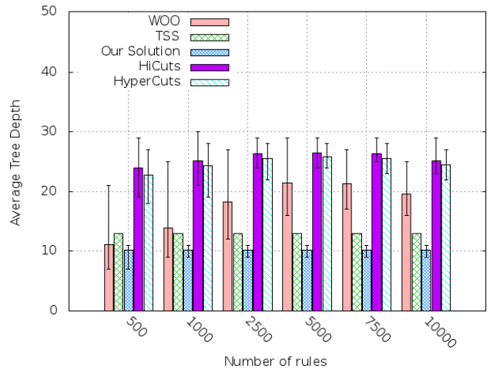
Performance Evaluation

Slide 19
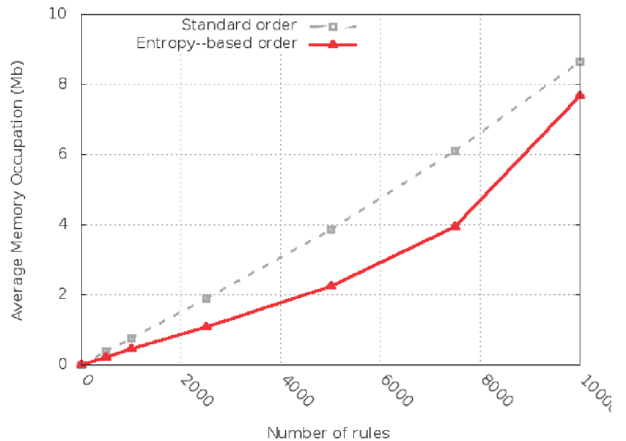
Performance Evaluation

